Slide 1
Lexical Analysis
.

Slide 2
An Overview of Compilation
source program
target program
lexical analyzer
code generator
symbol table
syntax analyzer
code optimizer
error handler
intermediate code generator
semantic analyzer

Slide 3
Overview of Lexical Analysis
First stage of a three-part frontend to help understand the source program
Processes every character in the input program
If a word is valid, then it is assigned to a syntactic category
This is similar to identifying the part of speech of an English word
Compilers are engineered objects.
noun verb adjective noun punctuation

Slide 4
Description of Lexical Analysis
Input:
A high level language program, such as a C or Java program, in the form of a
sequence of ASCII characters
Output:
A sequence of tokens along with attributes corresponding to different
syntactic categories that is forwarded to the parser for syntax analysis
Functionality:
Strips off blanks, tabs, newlines, and comments from the source program
Keeps track of line numbers and associates error messages from various parts
of a compiler with line numbers
Performs some preprocessor functions in languages like C

Slide 5
Recognizing Word “new”
c = getNextChar();
if (c == ‘n’)
c = getNextChar();
if (c == ‘e’)
c = getNextChar();
if (c == ‘w’)
report success; else
// Other logic
else
// Other logic
else
// Other logic
S₀
n
s₁
e
s
2
w
s₃

Slide 6
Formalism for Scanners

Slide 7
Definitions
An alphabet is a finite set of symbols
Typical symbols are letters, digits, and punctuations
ASCII and UNICODE are examples of alphabets
A string over an alphabet is a finite sequence of symbols drawn from that alphabet
A language is any countable set of strings over a fixed alphabet

Slide 8
Finite State Automaton
A finite state automaton (FSA) is a five-tuple or quintuple (𝑆, Σ, 𝛿, 𝑠₀, 𝑆_{𝐹})
𝑆 is a finite set of states
Σ is the alphabet or character set
It is the union of all edge labels in the FSA, and is finite.
𝛿(𝑠, 𝑐) represents the transition from state 𝑠 on input 𝑐
𝑠₀ ∈ S is the designated start state
𝑆_{𝐹} ⊆ 𝑆 is the set of final states
A FSA accepts a string 𝑥 if and only if
FSA starts in 𝑠₀
Execute transitions for the sequence of characters in 𝑥
Final state is an accepting state ∈ 𝑆_{𝐹} after 𝑥 has been consumed

Slide 9
FSA for recognizing “new”
FSA = (𝑆, Σ, 𝛿, 𝑠₀, 𝑆_{𝐹} )
𝑆 = (𝑠₀, 𝑠₁, 𝑠₂, 𝑠₃)
Σ = {𝑛, 𝑒, 𝑤}
S₀
n
𝑛 𝑒 𝑤
𝛿 = {𝑠₀ ՜ 𝑠₁, 𝑠₁ ՜ 𝑠₂, 𝑠₂ ՜ 𝑠₃}
𝑠₀ = 𝑠₀
𝑆_{𝐹} = {𝑠₃}
s₁
e
s₂
w
s₃
String is recognized in time proportional to the input

Slide 10
FSA for Unsigned Integers
char = getNextChar( )
state = 𝑠₀
while (char ≠ EOF and state state = 𝛿(state,char) char = getNextChar()
FSA = (𝑆, Σ, 𝛿, 𝑠₀, 𝑆_{𝐹} )
𝑆 = (𝑠 , 𝑠 , 𝑠 , 𝑠 )
0 1 2 𝑒
Σ = {0,1,2,3,4,5,6,7,8,9}
≠ 𝑠_{𝑒})
0 1−9
𝛿 = {𝑠₀ ՜ 𝑠₁, 𝑠₀ 𝑠₂,
0−9
0−9
𝑠₂ 𝑠₂, 𝑠₁ 𝑠_{𝑒}}
if (state ∈ 𝑆 )
𝐹
𝑠₀ = 𝑠₀
𝑆_{𝐹} = {𝑠₁, 𝑠₂}
report success else
report failure

Slide 11
Dealing with Erroneous Situations
FSA is in state 𝑠, the next input character is 𝑐, and 𝛿(𝑠, 𝑐) is not defined
FSA might process the complete input and still not be in the final state
Input string is a proper prefix for some word accepted by the FSA

Slide 12
Nondeterministic Finite Automaton
Nondeterministic finite automaton (NFA)
A FSA that allows transitions on the empty string 𝜖 and states that have multiple transitions on the same input character
Simulating an NFA
Always make the correct nondeterministic choice to follow transitions that lead to accepting state(s) for the input string, if such transitions exist
Try all nondeterministic choices in parallel to search the space of all possible
configurations

Slide 13
Regular Expressions
The set of words accepted by an FSA 𝐹 is called its language 𝐿(𝐹)
For any FSA 𝐹, we can also describe 𝐿(𝐹) using a notation called a regular expressions (RE)
The language described by a RE 𝑟 is called a regular language (denoted by 𝐿(𝑟))

Slide 14
Regular Expressions
𝜖 is a RE, 𝐿 𝜖 = {𝜖}
Let Σ be an alphabet, for each 𝑎 ∈ Σ, 𝑎 is a RE, and 𝐿 𝑎
= {𝑎}
𝑟 and 𝑠 are REs denoting the languages 𝑅 and 𝑆 respectively
Alternation (or union): (𝑟|𝑠) is a RE, 𝐿 𝑟 𝑠 = 𝑅|𝑆 = 𝑥 𝑥 ∈ 𝑅 or 𝑥 ∈ 𝑆 =
𝐿(𝑟) ∪ 𝐿(𝑠)
Concatenation: (𝑟𝑠) is a RE, 𝐿 𝑟𝑠 = 𝑅. 𝑆 = 𝑥𝑦 𝑥 ∈ 𝑅 ∧ 𝑦 ∈ 𝑆}
Closure: (𝑟∗) is an RE, 𝐿 𝑟∗ = 𝑅∗ = ڂ∞
_{𝑅}𝑖
𝑖=0
𝐿∗ is called the Kleene closure or closure of 𝐿

Slide 15
Examples of Regular Expressions
𝐿 = set of all strings of 0′s and 1′s
𝑟 = (0 + 1)∗
𝐿 = 𝑤 ∈ 0,1 ∗ 𝑤 has two or three occurences of 1, the first and second are not consecutive}
𝑟 = 0∗10∗010∗(10∗ + 𝜖)
𝐿 = 𝑤 𝑤 ∈ 𝑎, 𝑏 ∗ ∧ 𝑤 ends with 𝑎}
𝑟 = (𝑎 + 𝑏)∗𝑎

Slide 16
Examples of Regular Expressions
Unsigned real numbers with exponents
𝑟 = 0 1 … 9 0 … 9 ∗ . 0 … 9 ∗ 𝜖 𝐸(+| − |𝜖)(0|[1 … 9][0 … 9]∗)
𝐿 = 𝑤 ∈ 0,1 ∗ 𝑤 has no pair of consecutive zeros}
𝑟 = 1 + 01 ∗(0 + 𝜖)

Slide 17
Regular Expressions
We can reduce the use of parentheses by introducing precedence and associativity rules
Binary operators, closure, concatenation, and alternation are left associative
Precedence rule is
parentheses > closure > concatenation > alternation

Slide 18
Algebraic Laws for REs
Law | Description
𝑟|𝑠 = 𝑠|𝑟 | | is commutative
𝑟| 𝑠 𝑡 = 𝑟 𝑠 |𝑡 | | is associative
𝑟 𝑠𝑡 = 𝑟𝑠 𝑡 | Concatenation is commutative
𝑟 𝑠 𝑡 = 𝑟𝑠|𝑟𝑡; 𝑠 𝑡 𝑟 = 𝑠𝑟|𝑡𝑟 | Concatenation distributes over |
𝜖𝑟 = 𝑟𝜖 = 𝑟 | 𝜖 is the identity of concatenation
𝑟∗ = (𝑟|𝜖)∗ | 𝜖 is guaranteed in a closure
_{𝑟}∗∗ _{= 𝑟}∗ | ∗ is idempotent

Slide 19
Regular Definitions
Let 𝑟_{𝑖} be a regular expression and 𝑑_{𝑖} be a distinct name
Regular Definition is a sequence of definitions of the form
𝑑₁ ՜ 𝑟₁
𝑑₂ ՜ 𝑟₂
…
𝑑_{𝑛} ՜ 𝑟_{𝑛}
Each 𝑟_{𝑖} is a regular expression over the symbols Σ ∪ {𝑑₁, 𝑑₂, … , 𝑑_{𝑖−1}}
Each 𝑑_{𝑖} is a new symbol not in Σ

Slide 20
Example of Regular Definitions
Unsigned numbers
Example: 5280, 0.01234, 6.336E4, or 1.89E-4
𝑑𝑖𝑔𝑖𝑡 = 0 1 2 3 4 5 6 7 8|9
𝑑𝑖𝑔𝑖𝑡𝑠 = 𝑑𝑖𝑔𝑖𝑡 𝑑𝑖𝑔𝑖𝑡∗
…
…
…

Slide 21
Example of Regular Definitions
Unsigned numbers
Example: 5280, 0.01234, 6.336E4, or 1.89E-4
𝑑𝑖𝑔𝑖𝑡 = 0 1 2 3 4 5 6 7 8|9
𝑑𝑖𝑔𝑖𝑡𝑠 = 𝑑𝑖𝑔𝑖𝑡 𝑑𝑖𝑔𝑖𝑡∗
𝑜𝑝𝑡𝑓𝑟𝑎𝑐 = . 𝑑𝑖𝑔𝑖𝑡𝑠|𝜖
𝑜𝑝𝑡𝑒𝑥𝑝 = (𝐸 + − 𝜖 𝑑𝑖𝑔𝑖𝑡𝑠 |𝜖
𝑢𝑛𝑠𝑖𝑔𝑛𝑒𝑑𝑛𝑢𝑚 = 𝑑𝑖𝑔𝑖𝑡𝑠 𝑜𝑝𝑡𝑓𝑟𝑎𝑐 𝑜𝑝𝑡𝑒𝑥𝑝

Slide 22
Extensions of Regular Expressions
“.” is any character other than “\n”
[𝑥𝑦𝑧] is 𝑥|𝑦|𝑧
[𝑎𝑏𝑔−𝑝𝑇−𝑌] is any character 𝑎, 𝑏, 𝑔, … , 𝑝, 𝑇, … , 𝑌 [^𝐺−𝑄] is not any one of 𝐺, 𝐻, … , 𝑄
𝑟+ is one or more 𝑟’s
𝑟? is zero or one 𝑟

Slide 23
Regular Definition for Unsigned Numbers
𝑑𝑖𝑔𝑖𝑡𝑠 = 0 1 2 3 4 5 6 7 8|9
𝑑𝑖𝑔𝑖𝑡𝑠 = 𝑑𝑖𝑔𝑖𝑡 𝑑𝑖𝑔𝑖𝑡∗
𝑜𝑝𝑡𝑓𝑟𝑎𝑐 = . 𝑑𝑖𝑔𝑖𝑡𝑠|𝜖
𝑜𝑝𝑡𝑒𝑥𝑝 = (𝐸 + − 𝜖 𝑑𝑖𝑔𝑖𝑡𝑠 |𝜖
𝑢𝑛𝑠𝑖𝑔𝑛𝑒𝑑𝑛𝑢𝑚 = 𝑑𝑖𝑔𝑖𝑡𝑠 𝑜𝑝𝑡𝑓𝑟𝑎𝑐 𝑜𝑝𝑡𝑒𝑥𝑝
𝑑𝑖𝑔𝑖𝑡𝑠 = [0−9]
𝑑𝑖𝑔𝑖𝑡𝑠 = 𝑑𝑖𝑔𝑖𝑡⁺
𝑢𝑛𝑠𝑖𝑔𝑛𝑒𝑑𝑛𝑢𝑚 = 𝑑𝑖𝑔𝑖𝑡𝑠 . 𝑑𝑖𝑔𝑖𝑡𝑠 ? 𝐸 +− ? 𝑑𝑖𝑔𝑖𝑡𝑠 ?

Slide 24
Equivalence of RE and FSA
Let 𝑟 be an RE. Then there exists an NFA with 𝜖-transitions that accepts 𝐿(𝑟)
If 𝐿 is accepted by a DFA, then 𝐿 is generated by a RE
…

Slide 25
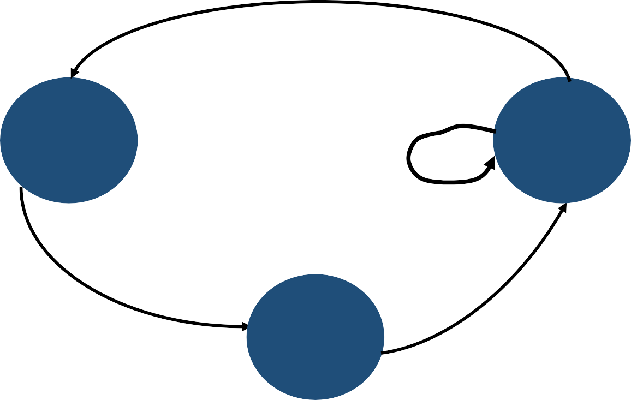
Equivalence of RE and FSA
Kleene’s
Construction
RE
DFA
DFA
Minimization
Thompson’s
Construction
Subset
Construction
NFA

Slide 26
NFA = (𝑁, Σ, 𝛿_{𝑁}, 𝑛₀, 𝑁_{𝐴})
NFA to DFA: Subset Construction
DFA = (𝐷, Σ, 𝛿_{𝐷}, 𝑑₀, 𝐷_{𝐴})
Subset Construction
𝑞₀ = 𝜖-closure({𝑠₀})
𝑄 = 𝑞₀
WorkList = {𝑞₀}
𝜖-closure
for each state 𝑛 ∈ 𝑁 do
𝐸 𝑛 = {𝑛}
WorkList = 𝑁
while (WorkList ≠ 𝜙) do remove 𝑛 from WorkList
while (WorkList ≠ 𝜙) do remove 𝑞 from WorkList for each character 𝑐 ∈ Σ do
𝑡 = 𝜖-closure(𝛿(𝑞, 𝑐))
𝑇 𝑞, 𝑐 = 𝑡
𝑡 = {𝑛} ∪ ڂ 𝐸(𝑝)
𝜖
𝑛՜𝑝∈𝛿_{𝑁}
if 𝑡 ≠ 𝐸(𝑛)
𝐸 𝑛 = 𝑡
if 𝑡 ∉ 𝑄 then
add 𝑡 to 𝑄 and to WorkList
𝜖
WorkList = WorkList ∪ {𝑚|𝑚 ՜ 𝑛 ∈ 𝛿_{𝑁}}

Slide 27
DFA to Minimal DFA: Hopcroft’s Algorithm
A DFA from Subset construction can have a large number of states
Does not increase the time needed to scan a string
Increases the space requirement of the scanner in memory
Speed of accesses to main memory may turn out to be the bottleneck
Smaller scanner has better chances of fitting in the processor cache

Slide 28
DFA to Minimal DFA: Hopcroft’s Algorithm
Minimization
Split(𝑺)
𝑇 = 𝐷_{𝐴}, 𝐷 − 𝐷_{𝐴}
𝑃 = 𝜙
while(𝑃 ≠ 𝑇) do
𝑃 = 𝑇
𝑇 = 𝜙
for each set
for each 𝑐 ∈ Σ do
if 𝑐 splits 𝑆 into
return {𝑠₁, 𝑠₂}
return 𝑆
𝑠₁ and 𝑠₂
𝑝 ∈ 𝑃 do
𝑇 = 𝑇 ∪ Split(𝑝)

Slide 29
Realizing Scanners

Slide 30
Tokens, Patterns, and Lexemes
f | l | o | a | t |  | a | b | s | _ | z | e | r | o |  | = |  | - | 2 | 7 | 3 | ; | / | * | K | e | l | v | i | n | * | /
Token
A string of characters which logically belong together in a syntactic category
Sentences consist of a string of tokens
For example, float, identifier, equal, minus, intnum, semicolon
Tokens are treated as terminal symbols of the grammar specifying the source language
May have an optional attribute

Slide 31
Tokens, Patterns, and Lexemes
Pattern
The rule describing the set of strings for which the same token is produced
The pattern is said to match each string in the set
float, letter(letter|digit|_)*, =, -, digit⁺, ;
Lexeme
The sequence of characters matched by a pattern to form the corresponding token
“float”, “abs_zero”, “=”, “-”, “273”, “;”
An attribute of a token is a value that the scanner extracts from the corresponding lexeme and supplies to the syntax analyzer
What can be important attributes? Where is this information stored?

Slide 32
Tokens in Programming Languages
Keywords, operators, identifiers (names), constants, literal strings, punctuation symbols (parentheses, brackets, commas, semicolons, and colons)
Attributes for tokens (apart from the integer representing the token)
identifier: the lexeme of the token, or a pointer into the symbol table where
the lexeme is stored by the LA
intnum: the value of the integer (similarly for floatnum, etc.)
string: the string itself
The exact set of attributes are dependent on the compiler designer

Slide 33
Role of a Lexical Analyzer
Identify tokens and corresponding lexemes
Construct constants: for example, convert a number to token num and pass the value as its attribute
31 becomes <num, 31>
Recognize keyword and identifiers
counter = counter + increment becomes id = id + id
Check that id here is not a keyword
Discard whatever does not contribute to parsing
White spaces (blanks, tabs, newlines) and comments

Slide 34
Specifying and Recognizing Patterns and Tokens
Patterns are denoted with regular expressions, and recognized with finite state automata
Regular definitions, a mechanism based on regular expressions, are popular for specification of tokens
Transition diagrams, a variant of finite state automata, are used to implement regular definitions and to recognize tokens
Usually used to model LA before translating them to executable programs

Slide 35
Transition Diagrams
Transition diagrams (TDs) are generalized DFAs with the following differences
Edges may be labelled by a symbol, a set of symbols, or a regular definition
Few accepting states may be indicated as retracting states
Indicates that the lexeme does not include the symbol that transitions to the accepting
state
Each accepting state has an action attached to it
Action is executed when the state is reached
Typically, such an action returns a token and its attribute value

Slide 36
Examples of Transition Diagrams
Identifiers and reserved words
𝑙𝑒𝑡𝑡𝑒𝑟 = 𝑎−𝑧𝐴−𝑍
𝑑𝑖𝑔𝑖𝑡 = [0−9]
𝑖𝑑𝑒𝑛𝑡𝑖𝑓𝑖𝑒𝑟 = 𝑙𝑒𝑡𝑡𝑒𝑟(𝑙𝑒𝑡𝑡𝑒𝑟|𝑑𝑖𝑔𝑖𝑡)∗
letter/digit
*
start
letter
other
0
1
2
return(get_token_code(), name)
* indicates a retraction state
get_token_code() searches a table to check if the name is a reserved word and returns its integer code if so
Otherwise, it returns the integer code of the IDENTIFIER token, with
name containing the string of characters forming the token
Name is not relevant for reserved words

Slide 37
A Sample Specification
𝑠𝑡𝑚𝑡 ⟶ if 𝑒𝑥𝑝𝑟 then 𝑠𝑡𝑚𝑡
| if 𝑒𝑥𝑝𝑟 then 𝑠𝑡𝑚𝑡 else 𝑠𝑡𝑚𝑡
| 𝜖
𝑒𝑥𝑝𝑟 ⟶ 𝑡𝑒𝑟𝑚 relop 𝑡𝑒𝑟𝑚
| 𝑡𝑒𝑟𝑚
𝑡𝑒𝑟𝑚 ⟶ id
| number
𝑑𝑖𝑔𝑖𝑡 ⟶ [0−9]
𝑑𝑖𝑔𝑖𝑡𝑠 ⟶ 𝑑𝑖𝑔𝑖𝑡⁺
𝑛𝑢𝑚𝑏𝑒𝑟 ⟶ 𝑑𝑖𝑔𝑖𝑡𝑠 . 𝑑𝑖𝑔𝑖𝑡𝑠 ? 𝐸 +− ? 𝑑𝑖𝑔𝑖𝑡𝑠 ?
𝑙𝑒𝑡𝑡𝑒𝑟 ⟶ [𝐴−𝑍𝑎 − 𝑧]
𝑖𝑑 ⟶ 𝑙𝑒𝑡𝑡𝑒𝑟 𝑙𝑒𝑡𝑡𝑒𝑟 𝑑𝑖𝑔𝑖𝑡)∗
𝑖𝑓 ⟶ if
𝑡ℎ𝑒𝑛 ⟶ then
𝑒𝑙𝑠𝑒 ⟶ else
𝑟𝑒𝑙𝑜𝑝 ⟶< | > <= >= | = | <>
𝑤𝑠 ⟶ blank tab | newline)⁺

Slide 38
Tokens, Lexemes, and Attributes
Lexemes | Token Name | Attribute Value
Any 𝑤𝑠 | -- | --
𝑖𝑓 | if | --
𝑡ℎ𝑒𝑛 | then | --
𝑒𝑙𝑠𝑒 | else | --
Any 𝑖𝑑 | id | Pointer to symbol table entry
Any 𝑛𝑢𝑚𝑏𝑒𝑟 | number | Pointer to symbol table entry
< | relop | LT
<= | relop | LE
= | relop | EQ
<> | relop | NE
> | relop | GT
>= | relop | GE

Slide 39
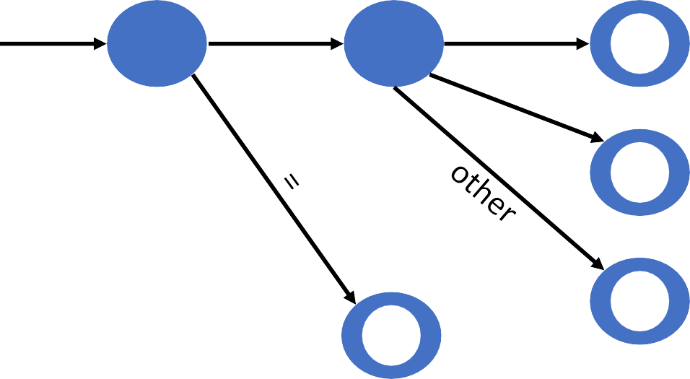
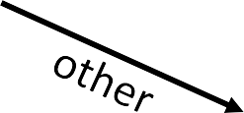
Transition Diagram for relop
start < =
0 1
2
>
return(relop, LE)
3
return(relop, NE)
4
return(relop, EQ)
*
5
return(relop, LT)
=
6
7
return(relop, GE)
*
8
return(relop, GT)

Slide 40
Transition Diagrams for IDs and Keywords
IDs and Keywords
letter/digit
*
start
letter
other
9
10
11
return(get_token_code(), name)
Whitespace
delim
*
start
delim
other
22
23
24

Slide 41
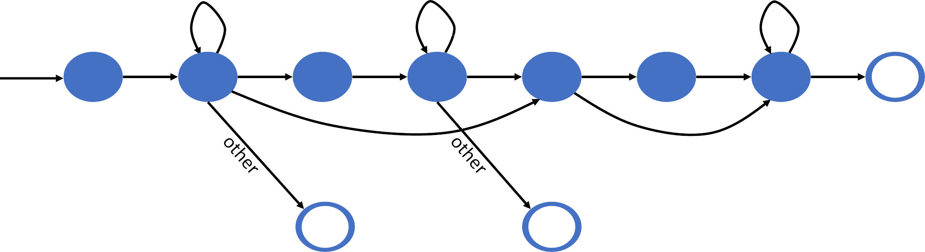
Transition Diagram for Unsigned Numbers
digit
digit
digit
.
*
start
digit
digit
E
+|-
digit
other
12
13
14
15
16
17
18
19
E
digit
*
*
20
21

Slide 42
Combining Transition Diagrams to form a Lexical Analyzer
Different transition diagrams (TDs) must be combined appropriately to yield a scanner
How do we do this?

Slide 43
Combining Transition Diagrams to form a Lexical Analyzer
Different transition diagrams (TDs) must be combined appropriately to yield a scanner
Try different transition diagrams one after another
For example, TDs for reserved words, constants, identifiers, and operators could be tried in that order
However, this does not use the “longest match” characteristic
thenext would be an identifier, and not reserved word then followed by identifier ext
To find the longest match, all TDs must be tried and the longest match must be used

Slide 44
Challenges in Lexical Analysis
Certain languages like PL/I do not have any reserved words
while, do, if, and else are reserved in C but not in PL/I
Makes it difficult for the scanner to distinguish between keywords and user- defined identifiers
if then then then = else else else = then
if if then then = then + 1

Slide 45
Challenges in Lexical Analysis
Certain languages like PL/I do not have any reserved words
while, do, if, and else are reserved in C but not in PL/I
Makes it difficult for the scanner to distinguish between keywords and user- defined identifiers
PL/I declarations
DECLARE(arg₁,arg₂,arg₃,…,arg_{n})
Cannot tell whether DECLARE is a keyword with variable definitions or is a
procedure with arguments until after “)”
Requires arbitrary lookahead and very large buffers
Worse, the buffers may have to be reloaded in case of wrong inferences

Slide 46
Challenges in Lexical Analysis
fi (a == g(x)) …
Is fi a typo or a function call?
Remember, fi is a valid lexeme for IDENTIFIER
Think C++
Template syntax: Foo<Bar>
Stream syntax: cin >> var;
Nested templates: Foo<Bar<Bazz>>
Can these problems be resolved by lexical analysers alone?

Slide 47
Challenges in Lexical Analysis
Consider a fixed-format language like Fortran
80 columns per line
Column 1-5 for the statement number/label column
Column 6 for continuation mark
Column 7-72 for the program statements
Column 73-80 Ignored (used for other purposes)
Letter C in Column 1 meant the current line is a comment

Slide 48
Challenges in Lexical Analysis
In fixed-format Fortran, some keywords are context-dependent
In the statement, DO 10 I = 10.86, DO10I is an identifier, and DO is not a keyword
But in the statement, DO 10 I = 10, 86, DO is a keyword
Blanks are not significant in Fortran and can appear in the midst of identifiers,
but not so in C
Variable “counter” is same as “count er”
In Fortran, blanks are important only in literal strings
Reading from left to right, one cannot distinguish between the two until the
“,” or “.” is reached
Requires look ahead for resolution

Slide 49
Programming Languages vs Natural Languages
Meaning of words in natural languages is often context-sensitive
An English word can be a noun or a verb (for e.g., “stress”)
“are” is a verb, “art” is a noun, and “arz” is undefined
Grammars are rigorously specified to provide meaning
Words in a programming language are always lexically specified
Any string in (1…9)(0…9)* is a positive integer

Slide 50
Why separate tokens and lexemes?
Rules to govern the lexical structure of a programming language is called its microsyntax
Separating syntax and microsyntax allows for a simpler parser
Parser only needs to deal with syntactic categories like IDENTIFIER

Slide 51
Lexical Analysis as a Separate Phase
Simplifies the compiler design
I/O issues are limited to only the lexical analyzer, so better portability
Allows designing a more compact and faster parser
Comments and whitespace need not be handled by the parser
A parser is more complicated than a lexical analyzer and shrinking the grammar makes
the parser faster
No rules for numbers, names, and comments are needed in the parser
Scanners based on finite automata are more efficient to implement than pushdown automata used for parsing (due to stack)

Slide 52
Interfacing with Parser
A unique integer representing the token is passed by LA to the parser
token
source
program
Lexical Analyzer
Syntax Analyzer
to semantic
analysis
get next token
symbol table

Slide 53
Error Handling in Lexical Analysis
LA cannot catch any other errors except for simple errors such as illegal symbols
In such cases, LA skips characters in the input until a well-formed token is found
This is called “panic mode” recovery
We can think of other possible recovery strategies
Delete one character from the remaining input, or insert a missing character
Replace a character, or transpose two adjacent characters
Idea is to see if a single (or few) transformation(s) can repair the error

Slide 54
Other Uses of Lexical Analysis Concepts
UNIX command line tools like grep, awk, and sed
Search tools in editors
Word-processing tools

Slide 55
Implementing Scanners

Slide 56
Implementing Scanners
Specify REs for each syntactic category
Construct an NFA for each RE
Join the NFAs with 𝜖-transitions
Create the equivalent DFA
Minimize the DFA
Generate code to implement the DFA

Slide 57
Implementation Considerations
Speed is paramount for scanning
Processes every character from an input source program
Repeatedly read the input character and simulate the corresponding DFA
Table-driven scanners
Direct-coded scanners
Hand-coded scanners

Slide 58
High-Level Idea in Implementing Scanners
Read input character one by one
Look up the transition based on the current state and the input character Switch to the new state
Check for termination conditions, i.e., accept and error Repeat

Slide 59
Table-Driven Scanner
Lexical Patterns
Scanner Generator
Tables
FSA
Interpreter
[0…9]
Register specification
For example, r1 and r27
r
[0…9]
s₀
s₁
s₂

Slide 60
Table-Driven Scanner
char = getNextChar() state = 𝑠₀
while (char ≠ EOF) state = 𝛿(state, char) char = getNextChar()
𝜹 | R | 0,1,…,9 | other
𝒔_{𝟎} | 𝑠₁ | 𝑠_{𝑒} | 𝑠_{𝑒}
𝒔_{𝟏} | 𝑠_{𝑒} | 𝑠₂ | 𝑠_{𝑒}
𝒔_{𝟐} | 𝑠_{𝑒} | 𝑠₂ | 𝑠_{𝑒}
𝒔_{𝒆} | 𝑠_{𝑒} | 𝑠_{𝑒} | 𝑠_{𝑒}
if (state accept
else
error
∈ 𝑆_{𝐹} )

Slide 61
Direct-Coded Scanner
goto 𝑠₀
𝑠₂:
char = nextChar()
if (‘0’ ≤ char ≤ ‘9’)
goto 𝑠₂
else if (char == EOF) accept
else
goto 𝑠_{𝑒}
𝑠₀:
char = getNextChar()
if (char == ‘r’)
goto 𝑠₁
else
goto
𝑠_{𝑒}
𝑠₁:
char = getNextChar()
if (‘0’ ≤ char ≤ ‘9’)
goto 𝑠₂
else
goto 𝑠_{𝑒}
𝑠_{𝑒}:
error

Slide 62
Hand-Coded Scanner
Many real-world compilers use hand-coded scanners for further efficiency
For e.g., gcc 4.0 uses hand-coded scanners in several of its front ends
Fetching a character one-by-one from I/O is expensive
Fetch a number of characters in one go and store in a buffer
Use double buffering

Slide 63
Reading Characters from Input
A scanner reads the input character by character
Reading the input will be very inefficient if it requires a system call for every character read
Input buffer
OS reads a block of data, supplies scanner the required amount, and stores
the remaining portion in a buffer called buffer cache
In subsequent calls, actual I/O does not take place as long as the data is available in the buffer cache
Scanner uses its own buffer since requesting OS for single character is also costly due to context-switching overhead

Slide 64
Optimizing Reads from the Buffer
A buffer at its end may contain an initial portion of a lexeme
E = M*C**2
 |  | E |  | = |  | M | *

Slide 65
Optimizing Reads from the Buffer
A buffer at its end may contain an initial portion of a lexeme
It creates problem in refilling the buffer, so a two-buffer scheme is used
The two buffers are filled alternatively
 |  | E |  | = |  | M | * | C | * | * | 2 | eof
forward
lexBegin

Slide 66
Optimizing Reads from the Buffer
Read from buffer
(1) Check for end of buffer, and (2) test the type of the input character
If end of buffer, then reload the other buffer
 |  | E |  | = |  | M | * | C | * | * | 2 | eof
forward
lexBegin

Slide 67
Advance Forward Pointer
if (forward is at end of | first buffer) | {
reload second buffer
forward = beginning of | second buffer
} else if (forward is at | end of second | buffer) {
reload first buffer
forward = beginning of | first buffer
} else {
forward++
}

Slide 68
Optimizing Reads from the Buffer
A sentinel character (say eof) is placed at the end of buffer to avoid two comparisons
 |  | E |  | = |  | M | eof | * | C | * | * | 2 | eof |  | eof
forward
lexBegin

Slide 69
Optimizing Reads from the Buffer
switch | (*forward++) {
case | eof:
if | (forward is at end of first buffer) | {
 | reload second buffer
 | forward = beginning of second buffer
} | else if (forward is at end of second | buffer) {
 | reload first buffer
 | forward = beginning of first buffer
} | else { // end of input
 | break
}
…
// case for other characters
}

Slide 70
Symbol Table
Stores information for subsequent phases
Symbol table interface
insert(s, t): save lexeme s and token t and return pointer
lookup(s): return index of entry for lexeme s or 0 if s is not found
Fixed amount of space to store lexemes might waste space

Slide 71
Implementation of Symbol Table
Fixed space for lexemes | Other attributes
Pointer to lexemes
Other attributes
32 bytes
4 bytes
lexeme1 | eos | lexeme2 | eos | …

Slide 72
Handling Keywords
Two choices: use separate REs or compare lexemes for ID token
Consider token DIV and MOD with lexemes div and mod
Initialize symbol table with insert(“div”, DIV) and
insert(“mod”, MOD) before beginning of scanning
Any subsequent insert fails
Any subsequent lookup returns the keyword value
These lexemes can no longer be used as an identifier

